Slide 1



Object Detection
Jaypee University, Anoopshahr
(Cats & Dogs)

Slide 2

Developed By
Guided By
Akash Dileep (8817103005)
Anubhav Ranjan (8817103011)
Devanshi Gupta (8817103013)
Dr. Nishant Shrivastava
HOD, Computer Science Department,
Jaypee University Anoopshahr

Slide 3

Content
Introduction
Algorithm Used & Its Working Diagram
Working Diagram Of The Project
Results
Future Scope
Improvement
Tools And Technology Used
References

Slide 4

INTRODUCTION

Slide 5

Introduction
Object detection is the task of finding and identifying objects in an image or video sequence.
Like human understanding, it includes :
Detection – of separate objects
Description – of their geometry and positions in 3D
Classification – as being one of a known class
Identification – of the particular instance
Understanding – of spatial relationships between objects

Slide 6
Detection - Are there people?

Slide 7
Verification – is this a lamp?

Slide 8
Identification – is that a palace?

Slide 9
Categorization
Mountain
Tree
Building
Lamp
People

Slide 10
Scene and context understanding
Outdoor
City
…….

Slide 11
Object detection
Object Detection = Object Classification + Object Localization

Slide 12

ALGORITHM USED

Slide 13
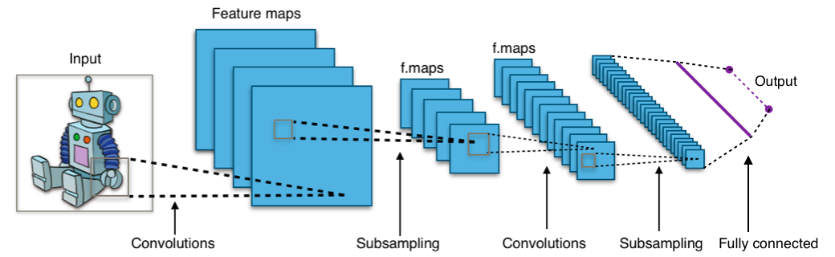
convolutional neural networks
Apply filters to small regions at a time to detect certain features of an object (edge, circle or certain shape).
A feature of an object is translation invariant, and the filters applied to each small region can share weights/parameters.
Fewer parameters required. More robust.

Slide 14
Layers of Cnn
Input Layer
Convolution Layer
Activation Function Layer
Pool Layer
Fully-Connected Layer

Slide 15
CNN (Working)
Creating Sequential Model
Adding To Convolutional 2D Matrix
Max Pooling / Saving The Important Data
Connecting The Layers
Converting To 1D Matrix
Adding To Convolutional 2D Matrix For Extra Features
Searching For Hidden Layers
Final Connected Layer

Slide 16
ABOUT PROJECT

Slide 17
Use case Diagram
Load The Dataset
Resize The Image To 150x150 Pixel And Read As Greyscale
Reading Dataset For Training
Building The Architecture
Generating Image With Different Perspective
Configuring Epochs, Batch Size & Train Samples
Configuring For Training
Predicting The Result

Slide 18

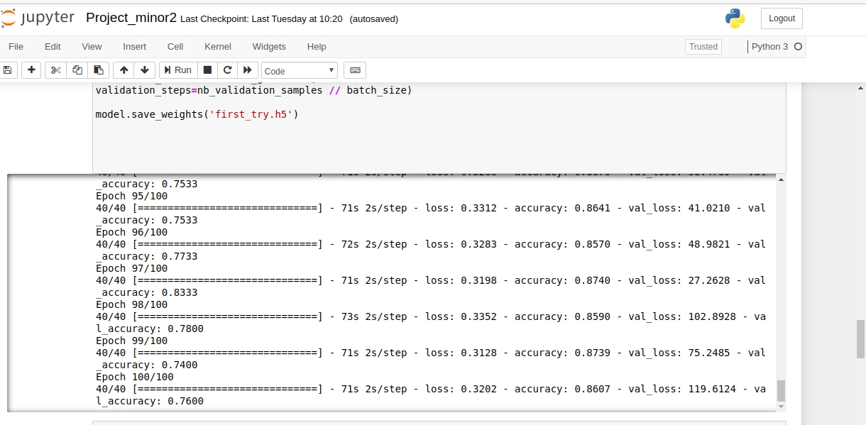
Training Result

Slide 19
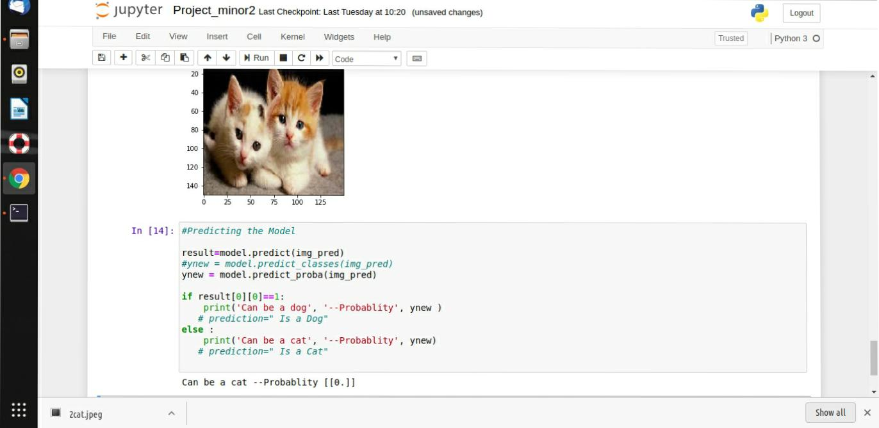
Result

Slide 20
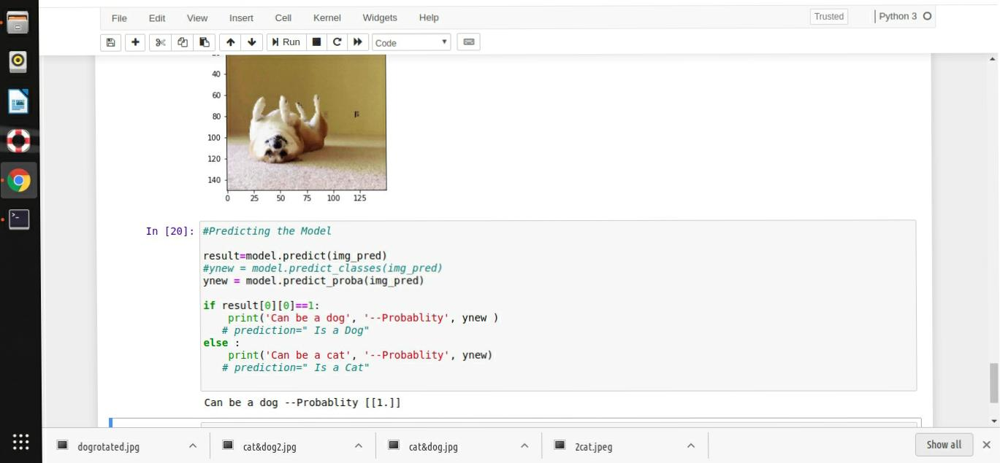
RESULT

Slide 21
Future scope
Autonomous Driving
Image Caption Generation
Automatic Game Playing
Various AI Fields

Slide 22
improvement
Dataset is noisy, improvement of dataset will lead to improved results.
Though the accuracy gained with this model is acceptable but can we improved with different configurations of batch size , epochs and greater dataset value.
For real time classification Fast R-CNN can be used.

Slide 23

Tools & technology used
Jupiter Notebook / Google Colaboratory
Testing Images
Hardware Requirements - AMD M5 430 GPU (For faster training)

Slide 24

References
Shaoqing Ren, Kaiming He, Ross Girshick, and Jian Sun. Faster R-CNN: Towards real- time object detection with region proposal networks. In Advances in Neural Information Processing Systems (NIPS), 2015.
Joseph Redmon, Santosh Divvala, Ross Girshick, and Ali Farhadi. You only look once: Unied, real-time object detection. In The IEEE Conference on Computer Vision and Pattern Recognition (CVPR), 2016.
https://www.geeksforgeeks.org/introduction-convolution-neural-network/

Slide 25
THANK YOU

